Slide 1
Theories & Applications of Shortest Paths on Networks
最短路徑於網路上之理論與應用
by
王 逸 琳 I-Lin Wang
ilinwang@mail.ncku.edu.tw
http://ilin.iim.ncku.edu.tw/ilin/
成功大學工業與資訊管理學系教授 2018/08/20-24 @ 成功校區 物理二館3樓 49323室

Slide 2

ZUVIO 學生版 課程代碼 15927124
Links to moodle https://moodle.ncku.edu.tw/
Download/Install this APP
May use in class quiz
Recommended links:
演算法筆記 http://www.csie.ntnu.edu.tw/~u91029/

Slide 3
Speaker’s background
Undergraduate (87~91) : Aerospace engineering, NCKU
Orbital mechanics
Master (94~96) : Operations Research Center, MIT
Prelimultiplier network simplex algorithm under Prof. Orlin
Researcher (96~97) : Network system lab, Fujitsu, JP
Optical network wavelength routing & assignment algorithm
Ph.D. (98~03) : ISyE, GA Tech
Shortest paths and multicommodity flows under Prof. Johnson
Assistant professor (03~07) : IIM, NCKU
Network optimization, Reverse logistics, Bioinformatics
Associate professor (07~14) : IIM, NCKU
Network optimization with applications in Transportation

Slide 4
Research Interests
Network Optimization
Logistics, Supply Chain Management
Shared Mobility
Resource Constrained Project Scheduling
Patrol Routing in MRT/Train/Rail Systems
Railway Optimization (INFORMS RAS PSC 6 awards)
Semiconductor Manufacturing
Pavement Optimization
Bioinformatics, Personal Navigation
Telecommunication, Network Reliability, Data Mining

Slide 5
Graph problem
Graph = Network
Examples of graph problems
Project management
Eularian Circuit
Hamiltonian Cycle

Slide 6
The Time to Complete a Project-1
To make the customer receive the adv by July 2, when should we start the whole process? Is June 2 ok?
 | Task | Day
A | Choose items from stock by dept manager | 3
B | Choose items to be brought in by buyers | 2
C | Choose & price items for adv by committee | 2
D | Prepare picture for sale item | 4
E | Prepare description for sale item | 3
F | Design adv | 2
G | Compile mailing list to send adv | 3
H | Print mailing labels | 1
I | Print adv | 5
J | Attach labels, stored adv by zip code | 2
K | Deliver adv | 10
Preceding Tasks
None
None
A,B
C
C
D,E
C
G
F
H,I
J
D
A
4
F
3
E
2
I
C
5
K
2
3
B
10
2
G
H
J
3
1
2
1.1: The Time to Complete a Project
Notes:
Buyer: 採買

Slide 7
The Time to Complete a Project-2
D
D
A3
4
A3
4
C=>max{3,2}+2
F
F
3
E
2
I
3
E
2
I
C
5
K
C5
5
K
2
3
2
3
B2
10
B2
10
2
G
H
J
2
G
H
J
3
1
2
3
1
2
D9
D9
4
4
F=>max{9,8}+2
A3
F
A3
F11
3
E8
2
I
3
E8
2
I
C5
5
K
C5
5
K
2
3
2
3
B2
10
B2
10
2
G8
H
J
2
G8
H9
J
3
1
2
3
1
2
D9
D9
A3
4
J=>max{9,16}+2
A3
4
F11
F11
3
E8
2
I16
3
E8
2
I16
C5
5
K
C5
5
K28
2
3
2
3
B2
10
B2
10
2
G8
H9
J18
2
G8
H9
J18
3
1
2
3
1
2
1.1: The Time to Complete a Project
Notes:
Task Time Length Preceding Tasks
A Choose items by dept manager 3 days None
B Choose items by buyers 2 None
C Choose & price items for ads 2 A,B
D Prepare picture for sale item 4 C
E Prepare word for sale item 3 C
F Design adv 2 D,E
G Compile mailing list 3 C
H Print mailing labels 1 G
I Print adv 5 F
J Attach labels, stored by zip code 2 H,I
K Deliver adv 10 J

Slide 8
Critical Path Analysis
At least need 28 days => June 2 is ok
Graph Properties:
Appearance is not unique
Acylic
PERT: Program Evaluation and Review Technique (1958 US Navy Polaris submarine and missile project)
Hang up the destination node, the longest path == critical path
D9
A3
4
F11
3
E8
2
I16
C5
5
K28
2
3
B2
10
2
G8
H9
J18
3
1
2
1.1: The Time to Complete a Project

Slide 9
The Bridges of Koenigsberg: Euler 1736
“Graph Theory” began in 1736
Leonard Eüler
Visited Koenigsberg
People wondered whether it is possible to take a walk, end up where you started from, and cross each bridge in Koenigsberg exactly once
Generally it was believed to be impossible

Slide 10
The Bridges of Koenigsberg: Euler 1736
A
1
2
3
B
4
C
5
6
7
D
Is it possible to start in A, cross over each bridge exactly once, and end up back in A?

Slide 11
The Bridges of Koenigsberg: Euler 1736
A
1
2
3
B
4
C
5
6
7
D
Conceptualization: Land masses are “nodes”.

Slide 12
The Bridges of Koenigsberg: Euler 1736
A
1
2
3
B
4
C
5
6
7
D
Conceptualization: Bridges are “arcs.”

Slide 13
The Bridges of Koenigsberg: Euler 1736
A
1
2
3
B
4
C
5
6
7
D
Is there a “walk” starting at A and ending at A and passing through each arc exactly once?

Slide 14
Network Notation
2
4
2
4
1
5
7
1
5
7
3
6
3
6
An Undirected Graph or
Undirected Network
A Directed Graph or
Directed Network
Network (or graph) G = (N, A)
N : Node Set = {1, 2, 3, 4, 5, 6, 7}
A : Arc Set = {(1, 2), (1, 3), (2, 3), (2, 4), (3, 6), (4, 5), (4, 7), (5, 2), (5, 3), (5, 7), (6, 7)}

Slide 15
Tails and Head Nodes
2
4
1
5
7
3
6
Tail Node : Node i is the tail node of arc (i, j)
Head Node : Node j is the head node of arc (i, j)
Endpoints : Nodes i and j are endpoints of arc (i, j)
(outgoing) Arc Adjacency List A(i) = {(i, j) : (i, j) ∈ A}
Observe that

Slide 16
Walks
2
4
1
5
7
3
6
Subgraph: G' = (N', A') is a subgraph of G = (N, A) if N' ⊆ N and A' ⊆ A.
Spanning Subgraph: G' = (N', A') is a spanning subgraph of G = (N, A) if N' = N and A' ⊆ A.
Walk: A walk in a directed graph G is a subgraph of G consisting of a sequence of nodes and arcs. (the arcs may have different orientations)
Directed Walk: A directed walk in which all arcs have the same orientation.

Slide 17
Paths and Cycles
2
4
2
4
1
5
7
1
5
7
3
6
3
6
(simple) Path : A walk without any repetition of nodes.
Directed Path: A directed walk without any repetition of nodes. (same orientation)
(simple) Cycle: A walk without any repetition of nodes except the same starting and ending nodes.
Directed Cycle: A directed version of a cycle. (same orientation)
Acyclic Network: A network that has no directed cycle.

Slide 18
Network Connectivity
2
4
2
4
1
5
7
1
5
7
3
6
3
6
Connected Graph: If every pair of nodes is connected by a path.
Strongly Connected Graph: If every pair of nodes is connected by a directed path.
Disconnected Graph: If some pair of nodes is not connected by a path.
Components: maximally connected subgraphs of a disconnected graph.
Notes:
Strongly connected: every node to every other node!! Check definitions in the book.

Slide 19
Trees
Tree: A tree is a connected graph that contains no cycle.
2
4
2
4
1
7
1
3
6
3
6
Properties:
A tree on n nodes contains exactly n-1 arcs.
A tree has at least two leaf nodes.
Every two nodes of a tree are connected by a unique path.

Slide 20
Spanning Trees
Spanning Tree: A subgraph of a graph which is a tree and contains every node of the graph.
2
4
2
4
1
5
7
1
5
7
3
6
3
6
Forest: A graph that contains no cycle is a forest. (thus a forest may contains several components which are trees)
A forest on n nodes and k components has n-k arcs.

Slide 21
Directed Out-Trees and In-Trees
Directed-out-tree: A tree in which the unique path in the tree from node s to every other node is a directed path.
Directed-in-tree: A tree in which the unique path in the tree from any node to node s is a directed path.
8
8
3
7
3
7
6
6
1
2
1
2
4
5
4
5

Slide 22
Back to the Bridges of Koenigsberg
b
1
2
a
c
e
4
d
3
5
Walks are paths that can repeat nodes and arcs
Example of a directed walk: 1-2-3-5-4-2-3-5
A walk is closed if its first and last nodes are the same.
A closed walk (circuit) is a cycle except that it can repeat nodes and arcs.

Slide 23
The Bridges of Koenigsberg: Euler 1736
A
1
2
3
B
4
C
5
6
7
D
Is there a “closed walk” passing through each arc exactly once?
Such a walk is called an eulerian circuit.

Slide 24
Hamiltonian Cycles
A hamiltonian cycle is a cycle that passes through each node of the graph exactly once.
This is often called a traveling salesman tour.

Slide 25
Hamilton’s Around the World Game
In 1857, the Irish mathematician, Sir William Rowan Hamilton invented a puzzle that he hoped would be very popular.
The objective was to make a hamiltonian cycle.
The game was not a commercial success, especially the 3D version. But the mathematics of hamiltonian cycles is very popular today.

Slide 26
Hamilton’s Around the World Game
This problem can be generalized to be the traveling salesman problem.

Slide 27
Traveling Salesman Problem
Given
a finite number of "cities"
the cost of travel between each pair of them
Find
the cheapest way of visiting all the cities and returning to your starting point.
Largest cases solved to date
15,112 cities in Germany
110 processors (Compaq EV6 Alpha at 500 MHz )
total computer time 22.6 years
TSP is NP hard
Heuristics (Local Search, GA, SA, Tabu search, Ant Colony, …etc)

Slide 28
Other related Graph Problems
Network restoration problem
Resourced constrained project scheduling problem

Slide 29
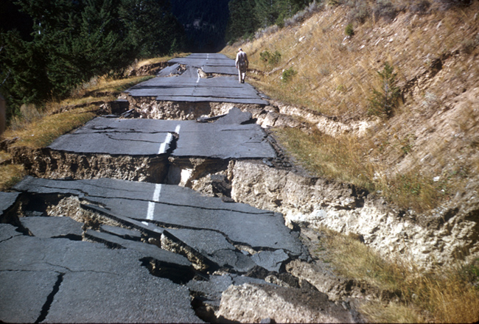
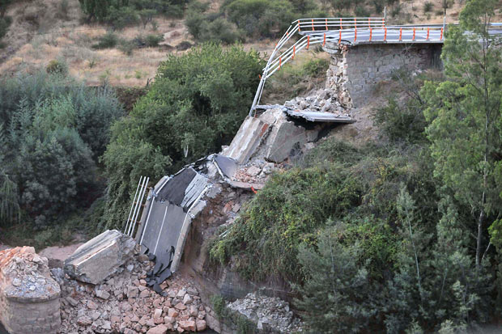
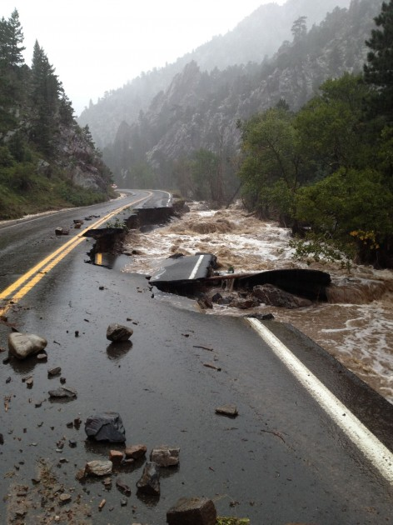
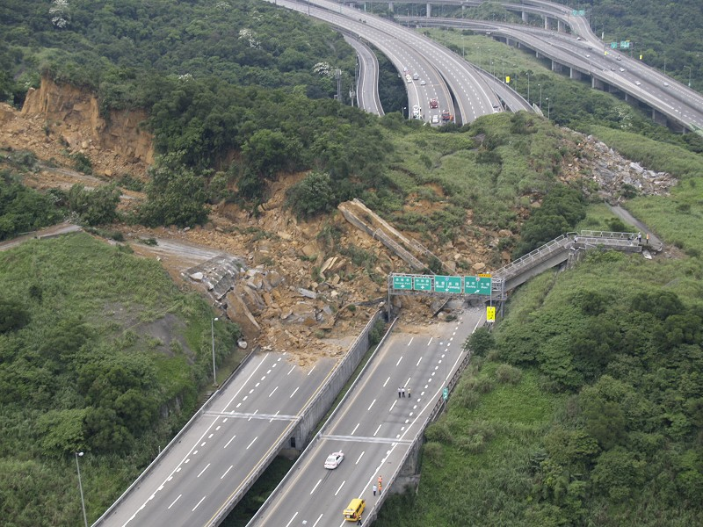

Slide 30
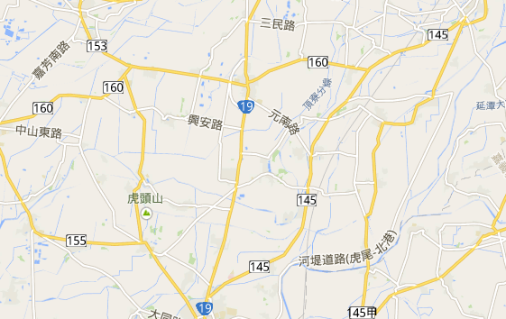



Q: which team to repair which arc at what time ?
shelter
Base
Resources
Broken road
Obj: all n-1 shelters to be reached a.s.a.p.

Slide 31
A Damaged Road Network Example
Given: 5 recovery team, 9 disconnected shelters
(2¹)
4
(1¹)
2
7
Starting Base
(4¹)
(4¹)
Disconnected
Shelter
(3¹)
(2¹)
(3¹)
(2¹)
1
(2¹)
5
(1¹)
(2¹)
8
(3¹)
(2¹)
10
(3¹)
(2¹)
3
(3¹)
6
(1¹)
9
(5¹)
Damaged Road
(2¹)
(repair time^{team})
Objective: Starting from 1, to repair damaged roads to reach all shelters in the shortest time

Slide 32
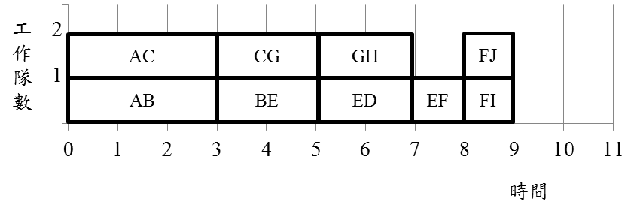
A Special RCPSP (2/2)
5
ED
BE
(2¹)
AB
8
FI
1
3
EF
(3¹)
(2¹)
6
(1¹)
0
FJ
10
9
(1¹)
Dummy source
AC
CG
(1¹)
Dummy sink
GH
2
4
7
(3¹)
(2¹)
(2¹)
Makespan = 9
# Team
Time

Slide 33
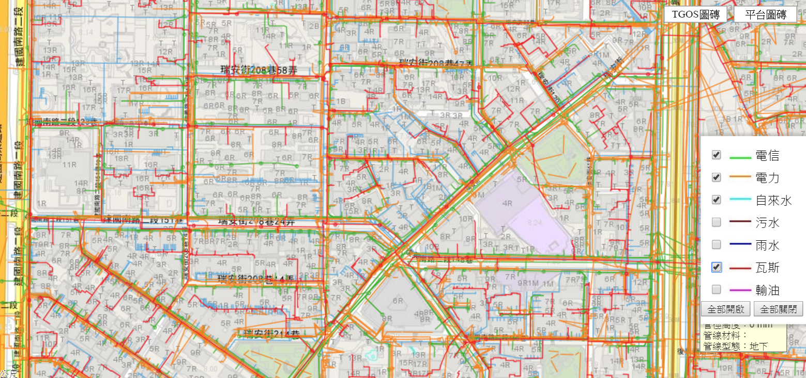
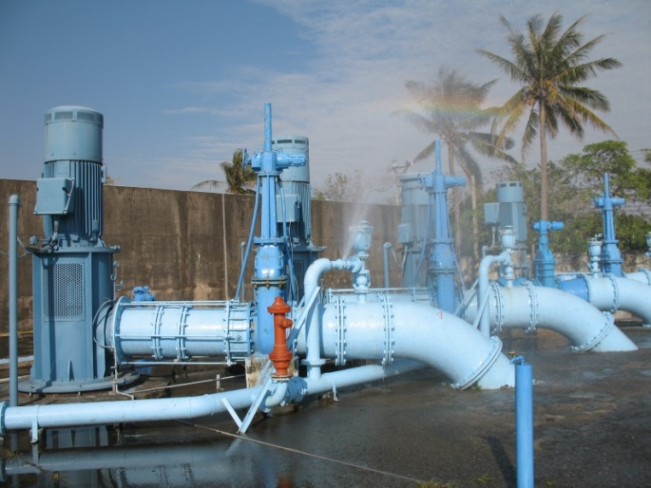
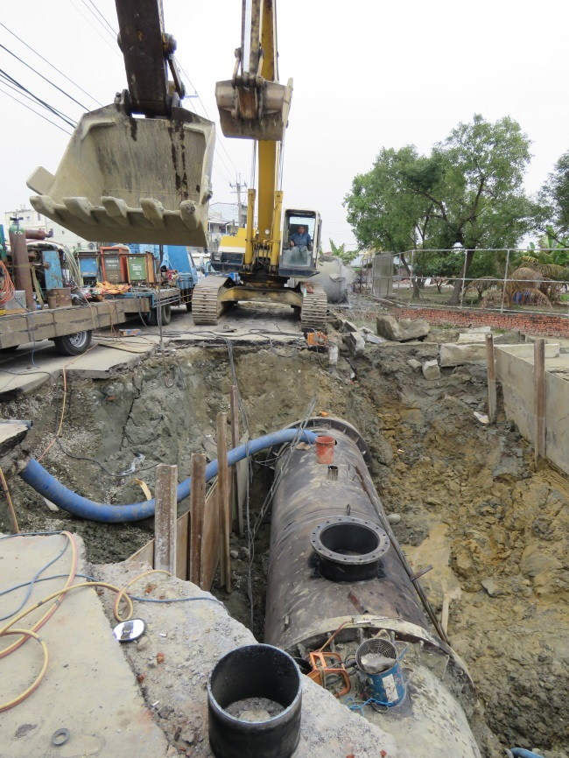
Underground Pipeline Networks

Slide 34
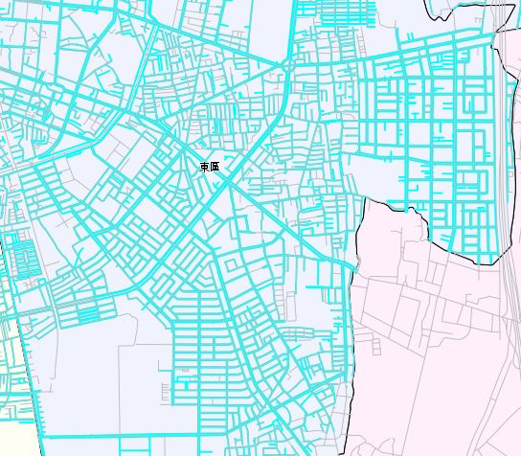
An Illustrative Example (1/2)
H
S
C
I
J
D
A
G
E
B
K
F
L

Slide 35

An Illustrative Example (2/2)
(demand, restoration time)
undamaged arc
H
(3, 7)
(5, 0)
S
damaged arc
(4, 5)
C
(2, 1)
I
(4, 0)
(3, 0)
(1, 3)
(2, 0)
J
(8, 2)
D
A
G
(3, 1)
(8, 0)
(7, 6)
(4, 2)
(6, 5)
(8, 0)
E
B
it incurs 5 units of waiting time for every disconnected demand unit
K
(5, 0)
(7, 0)
These demands
7、8、8、5、4 are still waiting now
F
L
(4, 0)

Slide 36

K-Repairmen Problem
Demands on each node at each period
Node only vs. OD pair
Node processing time
Travel time may be neglected
Min total waiting time
Base
6
2
3
9
4
8
On-going research!!
13
10
7
PART1
PART 2
PART 3
10
11

Slide 37
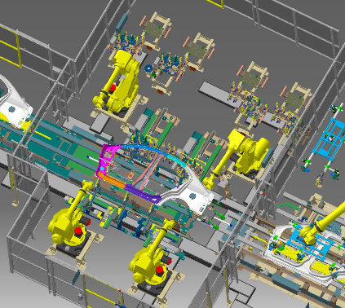
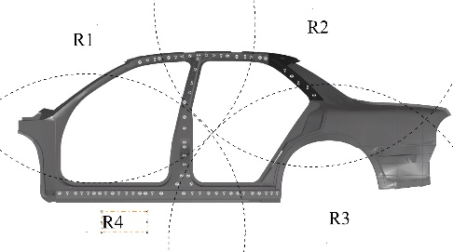
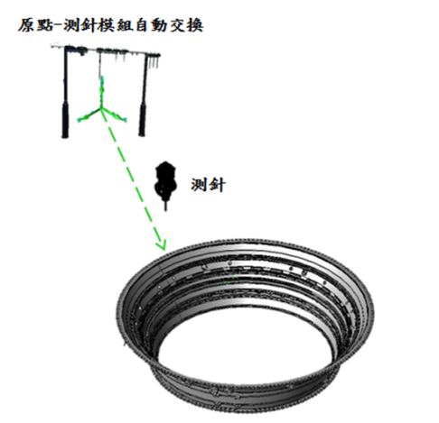
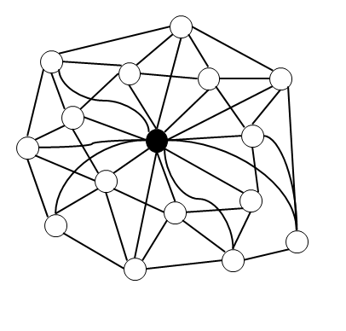
More Routing & Scheduling examples
汽車白車身點銲製程之最佳點銲路徑規劃
航太精密零件之單台空間測針最佳路徑規劃

Slide 38
Where Network Flows Arise
Transportation
Transportation of goods over transportation networks
Scheduling of fleets of airplanes: time/space networks
Manufacturing
Scheduling of goods for manufacturing
Flow of manufactured items within inventory systems
Communications
Design and expansion of communication systems
Flow of information across networks
Personnel Assignment
Assignment of crews to airline schedules
Assignment of drivers to vehicles
Notes:
See if I can tie this back to the student’s comments about thesis work.

Slide 39
The shortest path problem
Consider a network G = (N, A) in which there is an origin node s and a destination node t. standard notation: n = |N|, m = |A|
Determine a shortest path :
from s to t (1-ALL)
from each node to each other node (ALL-ALL)
from some nodes to some other nodes (SOME-SOME)
2
4
4
2
2
Applications:
Finding a path
of minimum length
taking minimum time
of maximum reliability
1
1
2
3
1
6
s
4
2
t
3
3
5
A Network with Arc Lengths

Slide 40
Complexity analysis
Estimation of resources (time & space)
Efficient algorithm
Easy problem vs. difficult problem

Slide 41
Trivial Upper bound-1
How many possible arrangements do we have to check?
How to use a logical way to cover all the possibilities?
The Multiplication Principle:
A procedure contains k steps
Step i needs n_{i} ways
Totally n₁*n₂*n₃*…*n_{k} ways
Permutations:
n factorial → n!=n* (n-1) *(n-2) * …*2*1
1.2: A Matching Problem

Slide 42
Trivial Upper bound-2
Thm 1.1
There are exactly n! permutations of a set of n objects
Thm 1.2
# ways an ordered list of r objects can be chosen without repetition from n objects is n!/(n-r)!
Permutations of n objects, taken r at a time
P(n,r)=n!/(n-r)!
Example: suppose a computer can generate 10⁶ arrangements a second
7!=5040 ok
20! 2.4*10¹⁸ 2.4*10¹² sec 7.6*10⁴ yr !!
Notes:
Thm1.2: n*(n-1)*(n-2)*…*(n-r+1)

Slide 43
Algorithms & Their Efficiency
For calculating the critical path: there are efficient algorithms
For the Hamiltonian path problem: there are still NO efficient algorithms known by today
Question:
How to measure the efficiency of an algorithm?
Answer:
Counting the total # of elementary operations (addition, comparison,..,etc) in terms of the input size of a problem → Complexity (theoretical running time)
Elementary operations:
addition, comparison, multiplication, division,…etc
Ignore value assignment e.g. x=3
1.4: Algorithms and Their Efficiency

Slide 44
Complexity Analysis
Disadvantages:
Assume each element operation takes the same amount of time
Multiplication/division takes longer than addition & comparison
Should also depends on the size of the numbers involved
Ignore the physical memory limitation
When additional memory is required, speed becomes slower
Ignore the time spent on assigning values to variables
Which one is better? n! , 2^{n}, n², log(n), loglog(n) ?
loglog(n) > log(n) > n² > 2^{n} > n! (A>B means A is better than B)
Good complexity:
a polynomial function of the input size (n) of the problem
f(n)=c_{k}n^{k} + c_{k-1}n^{k-1} + … + c₂n² + c₁n + c₀ e.g. n²
1.4: Algorithms and Their Efficiency

Slide 45
Evaluating x^{n}
Problem: given x and n give an algorithm to evaluate x^{n}
Intuitive algorithm: (the following format is called a pseudo code)
Complexity:
n-1 multiplication, n-1 addition, n comparison → 3n-2
begin
initialization: Set P=x , k=1
while k < n do
P=Px
k=k+1
end while
output P=x^{n}
end
1.4: Algorithms and Their Efficiency
Notes:
Explain what “pseudo code” is

Slide 46
Evaluating a Polynomial of Degree n in x
Problem: given x, n, and {a_{i}: i=0~n}
give an algorithm to evaluate P(x)=a_{n}x^{n} + a_{n-1}x^{n-1} + … + a₂x² + a₁x + a₀
Intuitive algorithm:
Complexity:
for k=1~n, we have 1 multiplication, 2 addition, 1 comparison, and 3k-2 operations for x^{k} → 1+2+1+3k-2=3k+2
total # operations: =1.5n²+3.5n , for k=1~n plus the last comparison when k=n+1, Total # operations= 1.5n²+3.5n+1
begin
initialization: Set S= a₀ , k=1
while k ≤ n do
S=S+ a_{k}x^{k}
k=k+1
end while
output S=P(x)
end
1.4: Algorithms and Their Efficiency

Slide 47
Horner’s Polynomial Evaluation Algorithm
Problem: given x, n, and {a_{i}: i=0~n}
give an algorithm to evaluate P(x)=a_{n}x^{n} + a_{n-1}x^{n-1} + … + a₂x² + a₁x + a₀
Horner’s algorithm: (in 1819, an English schoolmaster): Idea: P(x)=x(x(x(…x(a_{n})+a_{n-1})+…+) a₂)+ a₁)+ a₀
Complexity:
for k=1~n, we have 1 multiplication, 2 addition, 1 comparison, and 1 subtraction → 1+2+1+1=5 operations
total # operations: = 5n , for k=1~n plus the last comparison when k=n+1, Total # operations= 5n+1
begin
initialization: Set S= a_{n} , k=1
while k ≤ n do
S=xS+ a_{n-k}
k=k+1
end while
output S=P(x)
end
1.4: Algorithms and Their Efficiency

Slide 48
Big O Notation
Supplementary material
from the previous example, total # operations of 2 algorithms: 1.5n²+3.5n+1 vs. 5n+1
When n becomes large, the effect of n² > the effect of n
Thus, if the total # operations is f(n)=c_{k}n^{k} + c_{k-1}n^{k-1} + … + c₂n² + c₁n + a₀ we say the algorithm has order at most n^{k} (i.e., the most dominated term)
i.e. f(n)≤Cn^{k} , where C is some constant e.g. 1.5n²+3.5n+1≤ 1.5n²+4.5n² ≤6n²
e.g. the algorithm with order at most n^{k} has a complexity O(n^{k})
An algorithm is said to run in O(f(n)) time if for some numbers c and n₀, the time taken by the algorithm is at most cf(n) for all n≥n₀
1.4: Algorithms and Their Efficiency

Slide 49
Growth Rates of Functions of n
Supplementary material
n | logn | n^{0.5} | n² | n³ | 2^{n} | n!
10 | 3.32 | 3.16 | 10² | 10³ | 10³ | 3.6x 10⁶
100 | 6.64 | 10.00 | 10⁴ | 10⁶ | 1.27x 10³⁰ | 9.33x 10¹⁵⁷
1000 | 9.97 | 31.62 | 10⁶ | 10⁹ | 1.07x 10³⁰¹ | 4.02x 10²⁵⁶⁷
10000 | 13.29 | 100.00 | 10⁸ | 10¹² | 0.99x 10³⁰¹⁰ | 2.85x 10³⁵⁶⁵⁹
An algorithm is “good” or “efficient”, if its worst-case complexity is bounded by a polynomial function of the problem’s parameters
An exponential-time algorithm has a worst-case running time grows as a function that cannot be polynomially bounded by the input length
log n is polynomially bounded because its growth rate is slower than n
examples of exponential time complexity: O(2^{n}), O(n!), O(n^{logn})
1.4: Algorithms and Their Efficiency
Notes:
May need to explain what the “worst case” means
Mention P, NP

Slide 50
Bubble Sort Algorithm-1
Problem: given n numbers a₁ , a₂ , a₃ , … , a_{n-1} , a_{n} give an algorithm to sort these numbers in ascending order
Idea: first try to make the smallest of the n numbers to be the 1st position then the smallest of the remaining n-1 numbers to be the 2nd position then the smallest of the remaining n-2 numbers,…etc
Bubble Sort Algorithm:
begin
for j=1 to n-1 do
for k=n-1 to j by -1 do
if a_{k+1}< a_{k} then
interchange a_{k+1}and a_{k}
end for
end for
output a₁, a₂, a₃, … , a_{n-1}, a_{n}
end
1.4: Algorithms and Their Efficiency

Slide 51
Bubble Sort Algorithm-2
e.g. 7, 6, 14, 2 → 7, 6, 2, 14 → 7, 2, 6, 14 → 2, 7, 6, 14 → 2, 6, 7, 14
Complexity:
# comparisons: (n-1)+(n-2)+…+2+1= n(n-1)/2
O(n²)
1.4: Algorithms and Their Efficiency

Slide 52
Size of a problem
The size of a problem is the number of bits needed to represent the problem.
In networks, usually we use n=|N|, m=|A|, log C, log U as the size of a problem
The size of the n × m matrix A is not nm.
If each matrix element has K bits, the size is nmK
e.g., if max 2¹⁰⁷ < a_{ij} < 2¹⁰⁸, then K = 108.
K = O( log (a_{max})).

Slide 53
Polynomial Time Algorithms
We say that an algorithm runs in polynomial time if the number of steps taken by an algorithm on any instance I is bounded by a polynomial in the size of I.
We say that an algorithm runs in exponential time if it does NOT run in polynomial time.
Example 1: finding the determinant of a matrix can be done in O(n³) steps.
This is polynomial time.

Slide 54
Polynomial Time Algorithms
Example 2: We can determine if n is prime by dividing n by every integer less than n.
This algorithm is exponential time.
The size of the instance is log n
The running time of the algorithm is O(n).
Side note: there is a polynomial time algorithm for determining if n is prime. (2002, a simple deterministic algorithm)
Almost all of the algorithms presented in this class will be polynomial time.
One can find an Eulerian circuit (if one exists) in O(m) steps.
There is NO known polynomial time algorithm for finding a hamiltonian cycle.
Notes:
http://www.cse.iitk.ac.in/news/primality.html

Slide 55
More examples on complexity
Polynomial Time Algorithms
Examples: O(n²), O(nm), O(m + n log n), O(m log C).
Exponential Time Algorithms
Examples: O(2^{n}), O(n!)
Pseudo-Polynomial Time Algorithms
Examples: O(m+nC).

Slide 56
On polynomial vs. exponential time
We contrast two algorithm, one that takes 30,000 n³ steps, and one that takes 2^{n} steps.
Suppose that we could carry out 1 billion steps per second.
# of nodes 30,000 n³ steps 2^{n} steps
n = 30, 0.81 seconds 1 second
n = 40, 1.92 seconds 17 minutes
n = 50 3.75 seconds 12 days
n = 60 6.48 seconds 31 years

Slide 57
Growth Rates of Various Functions

Slide 58

Efficient algorithms? (1)
“I can’t find an efficient algorithm, I guess I’m just too dumb.”
Serious damage to your
position within the company !!!

Slide 59

Efficient algorithms? (2)
“I can’t find an efficient algorithm, because no such algorithm is possible!”
Unfortunately, proving intractability can be just
as hard as finding efficient algorithms !!!
∴ No hope !!!
P ≠ NP

Slide 60
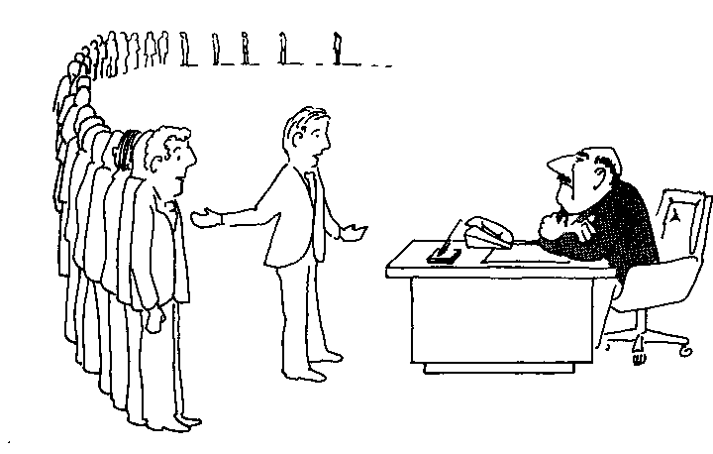
Efficient algorithms? (3)
“I can’t find an efficient algorithm, but neither can all these famous people”

Slide 61

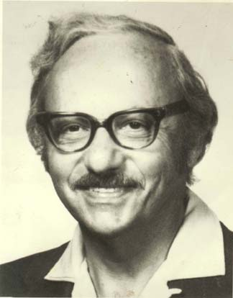
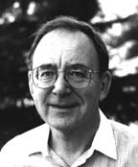
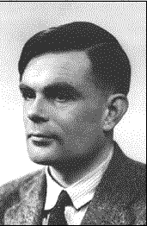

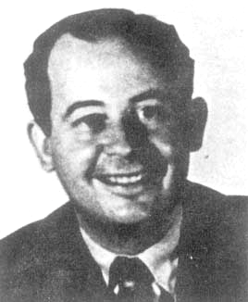
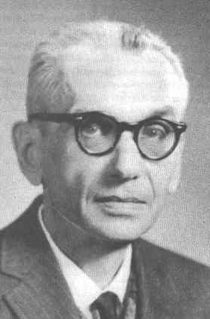


David Johnson
George Dantzig
Richard Karp
Alan Turing
Michael Garey
Ralph Gomory
John Von Neumann
Kurt Gödel
Steven Cook

Slide 62

Efficient algorithms? (4)
“Anyway, we have to solve this problem.
Can we satisfy with a good solution ? “

Slide 63
Q & A
Thanks!
I-Lin Wang (王逸琳)
Professor
Dept of Industrial & Information Management
National Cheng Kung University http://ilin.iim.ncku.edu.tw/

